Slide 1
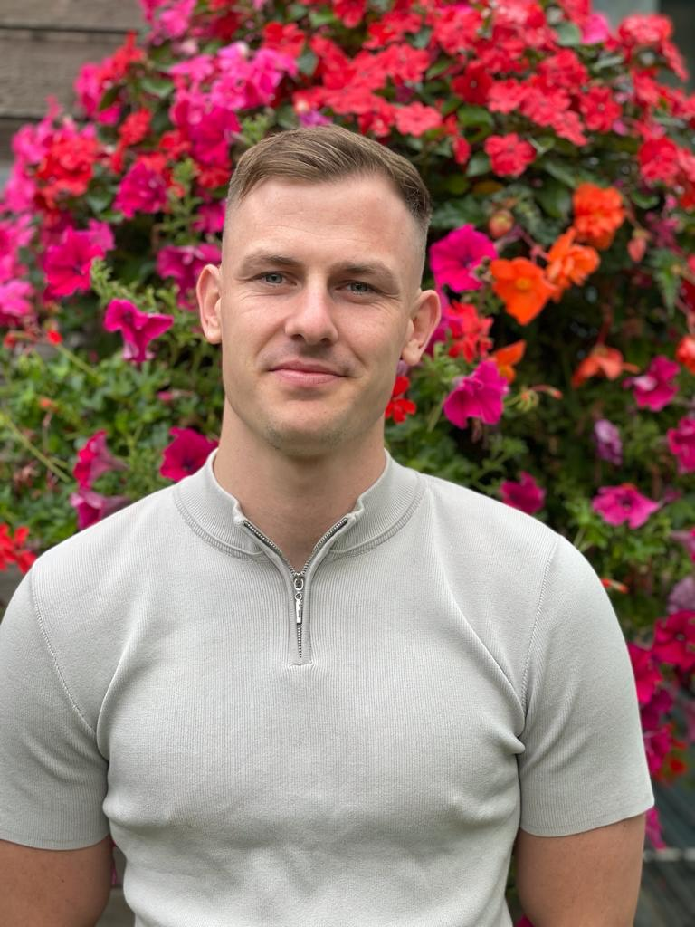
Welcome to Rhino Class
Meet the Teacher
Jaydon

Slide 2



Ways we celebrate success in Rhino Class!
Golden certificate on Fridays
A WOW! Postcard home
A phone call/conversation to mention success
Hot chocolate with Liz on a Friday!

Slide 3
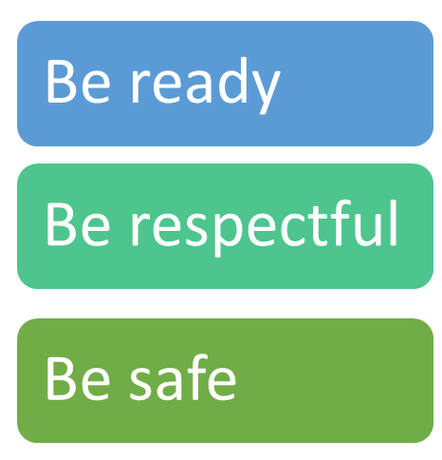
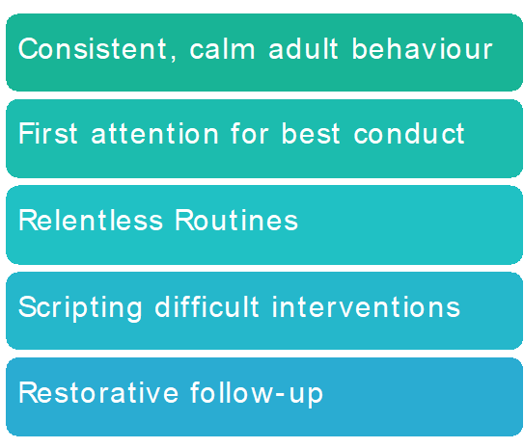
Behaviour at Kew
 | Steps | Actions
1 | Reminder | A reminder of the three simple rules (ready, respectful, safe)
2 | Caution | A clear verbal caution outlining behaviour and consequence
3 | Last chance | Speak to the student privately and give them a final opportunity to engage. Use the 30 second scripted intervention. (2 minutes after class)
4 | Time out | Thinking seat or equivalent – 5 minutes
5 | Linked class | Further cool off time 10 – 20 minutes
6 | Repair | This might be a quick chat at break time or a more formal meeting.
You will be notified if your child has been sent to a linked class or has had to speak to a member of the leadership team.

Slide 4
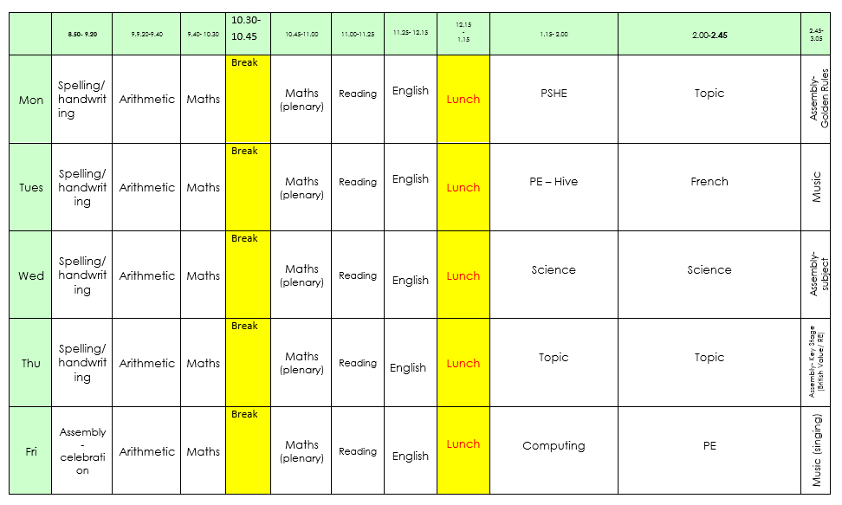
Notes:
4
Motivate Sessions are on Monday and Tuesday afternoons. Please ensure your child comes with a complete kit both days.
Science will be taught by our deputy-head, Sonia. Our first topic is “Earth, Sun and Moon.”
Music will be taught by Marinus on Thursday afternoons.
Children will be given some class time to work on Heads Awards, but will also need to work on them outside of school as well. Options follow on Friday Afternoon.

Slide 5
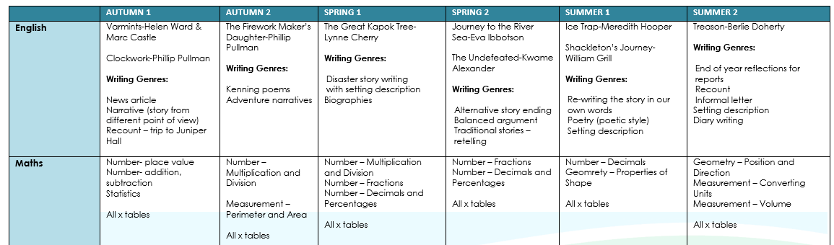
Curriculum Map (blocking)

Slide 6
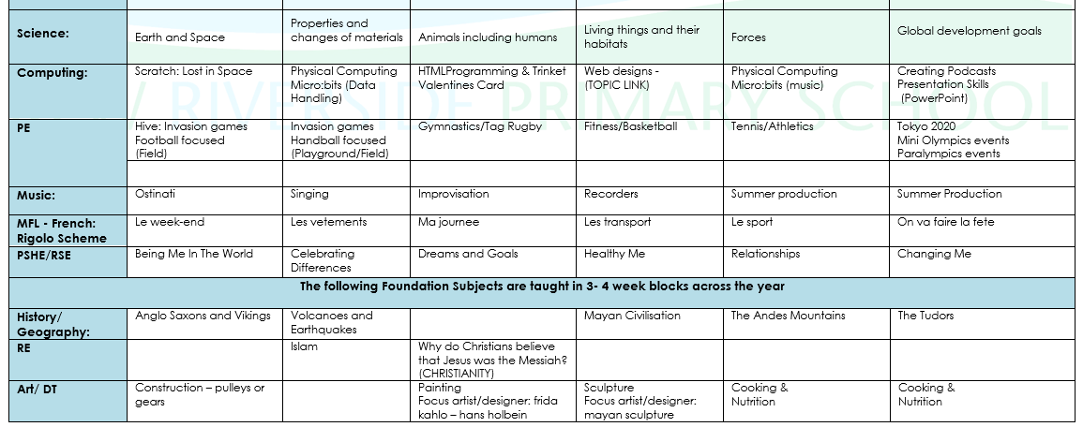

Slide 7
Uniform reminders
Navy blue or black sturdy shoes or all-black (no logo) trainers
Hair ties/accessories should be plain and dark – preferably black
Watches should be small and plain – no Smart watches with internet access
It is more important that ever that uniform is clearly labelled with your child’s name
For more details about school uniform, please refer to the School Website under Policies and Guidelines

Slide 8
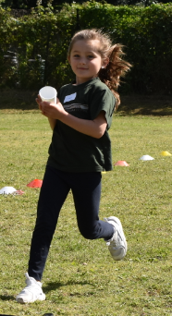

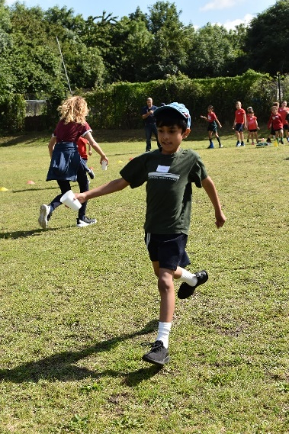
PE days and kit
A reminder that for the foreseeable future, children should come to school in their PE kit on their PE days.
PE days in Rhino Class class are Tuesday and Friday
There are currently no swimming lessons taking place.

Slide 9



Home Learning
Home Learning will go out on a Friday
Home Learning will include:
Spellings will be sent home weekly to be learned. Along with a Spelling Shed online activity.
NB Spelling tests will take place at the end of a unit of work (approximately every 2-3 weeks)
Children should complete the assigned MyMaths and Times Table Rock Stars activities and weekly.
In class Rhino Class –
Year 5: All x and ÷ facts (12x12)
The Year Groups KIRFs (Key Instant Recall Facts) will be attached to the Home Learning

Slide 10
Home Leaning- Reading
It is very important that children continue to read at home on a daily basis for a minimum of 10 minutes. Reading Records must be completed each day and given in on Wednesday.
Your children’s books will be changed on Friday.
We want all children to develop a love of reading. Reading underpins the whole curriculum and there is much evidence to support our belief that reading is the key to success not just in school but in all aspects of life. One of the most important ways in which you can support your child in school is to encourage them to read to you and for you to read to them.
Children in Key Stage 2 take home:
1x Big Cat banded book
1x free reader (changed as needed)

Slide 11
Book Bands
EYFS/Key Stage 1:
Key Stage 2:
NB: In Key Stage 2 their is progression within the content of the books within each band

Slide 12
Some reading recommendations for Year X
Books for Topics:
https://www.booksfortopics.com/year-5
Book Trust: https://www.booktrust.org.uk/
A Mighty Girl: https://www.amightygirl.com/books
Love Reading for Kids: https://www.lovereading4kids.co.uk/genre/bom/Books-of-the-Month.html
The Alligators Mouth Bookshop: https://www.thealligatorsmouth.co.uk/

Slide 13
Moments of Triumph Designed to develop individuals ready for the challenges that lay ahead.
In recent years, educationalists have been debating how school can explore traits (such as resilience and respect) which develop character.
Children and families minister Edward Timpson remarked, “Instilling positive character traits and academic excellence are two sides of the same coin – children that develop resilience are far more likely to succeed, not only in school but in later life, too.”
This initiative is designed to develop the emotional intelligence of the pupils at Kew Riverside Primary School. The project will be tracked over the course of the 2021 – 2022 academic year and impact will be measured.

Slide 14
Relationships and Sex Education (RSE)
In September 2020 the Health Education and Relationships Education aspects of PSHE (personal, social, health and economic) education became compulsory.
The Department for Education ‘continues to recommend that all primary schools should have a sex education programme tailored to the age and the physical and emotional maturity of the pupils’
Where schools provide sex education at key stages 1 and 2, parents will have the right to withdraw their child from sex education but not from statutory Relationships Education or Health Education. Parents will also now not be able to withdraw their children from the biological/reproductive aspects covered in science).

Slide 15
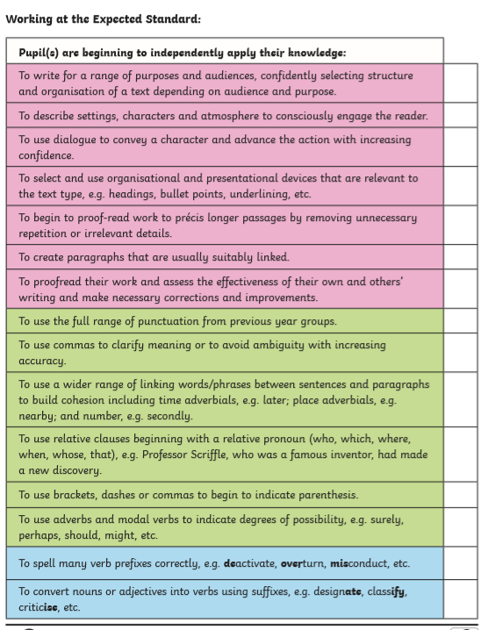
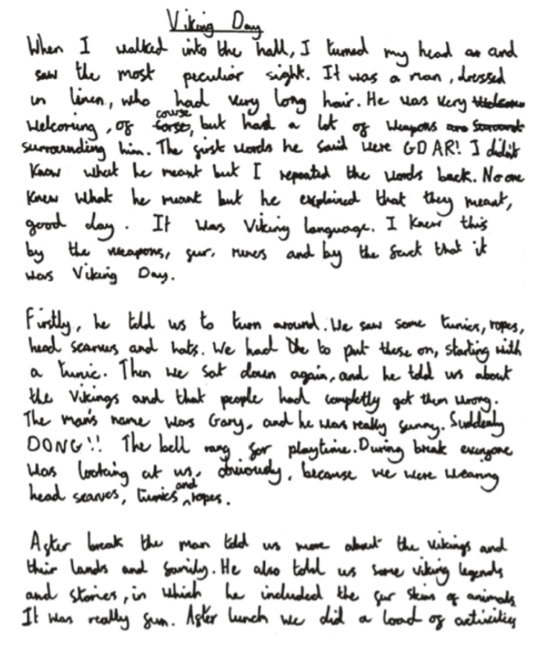
Writing

Slide 16
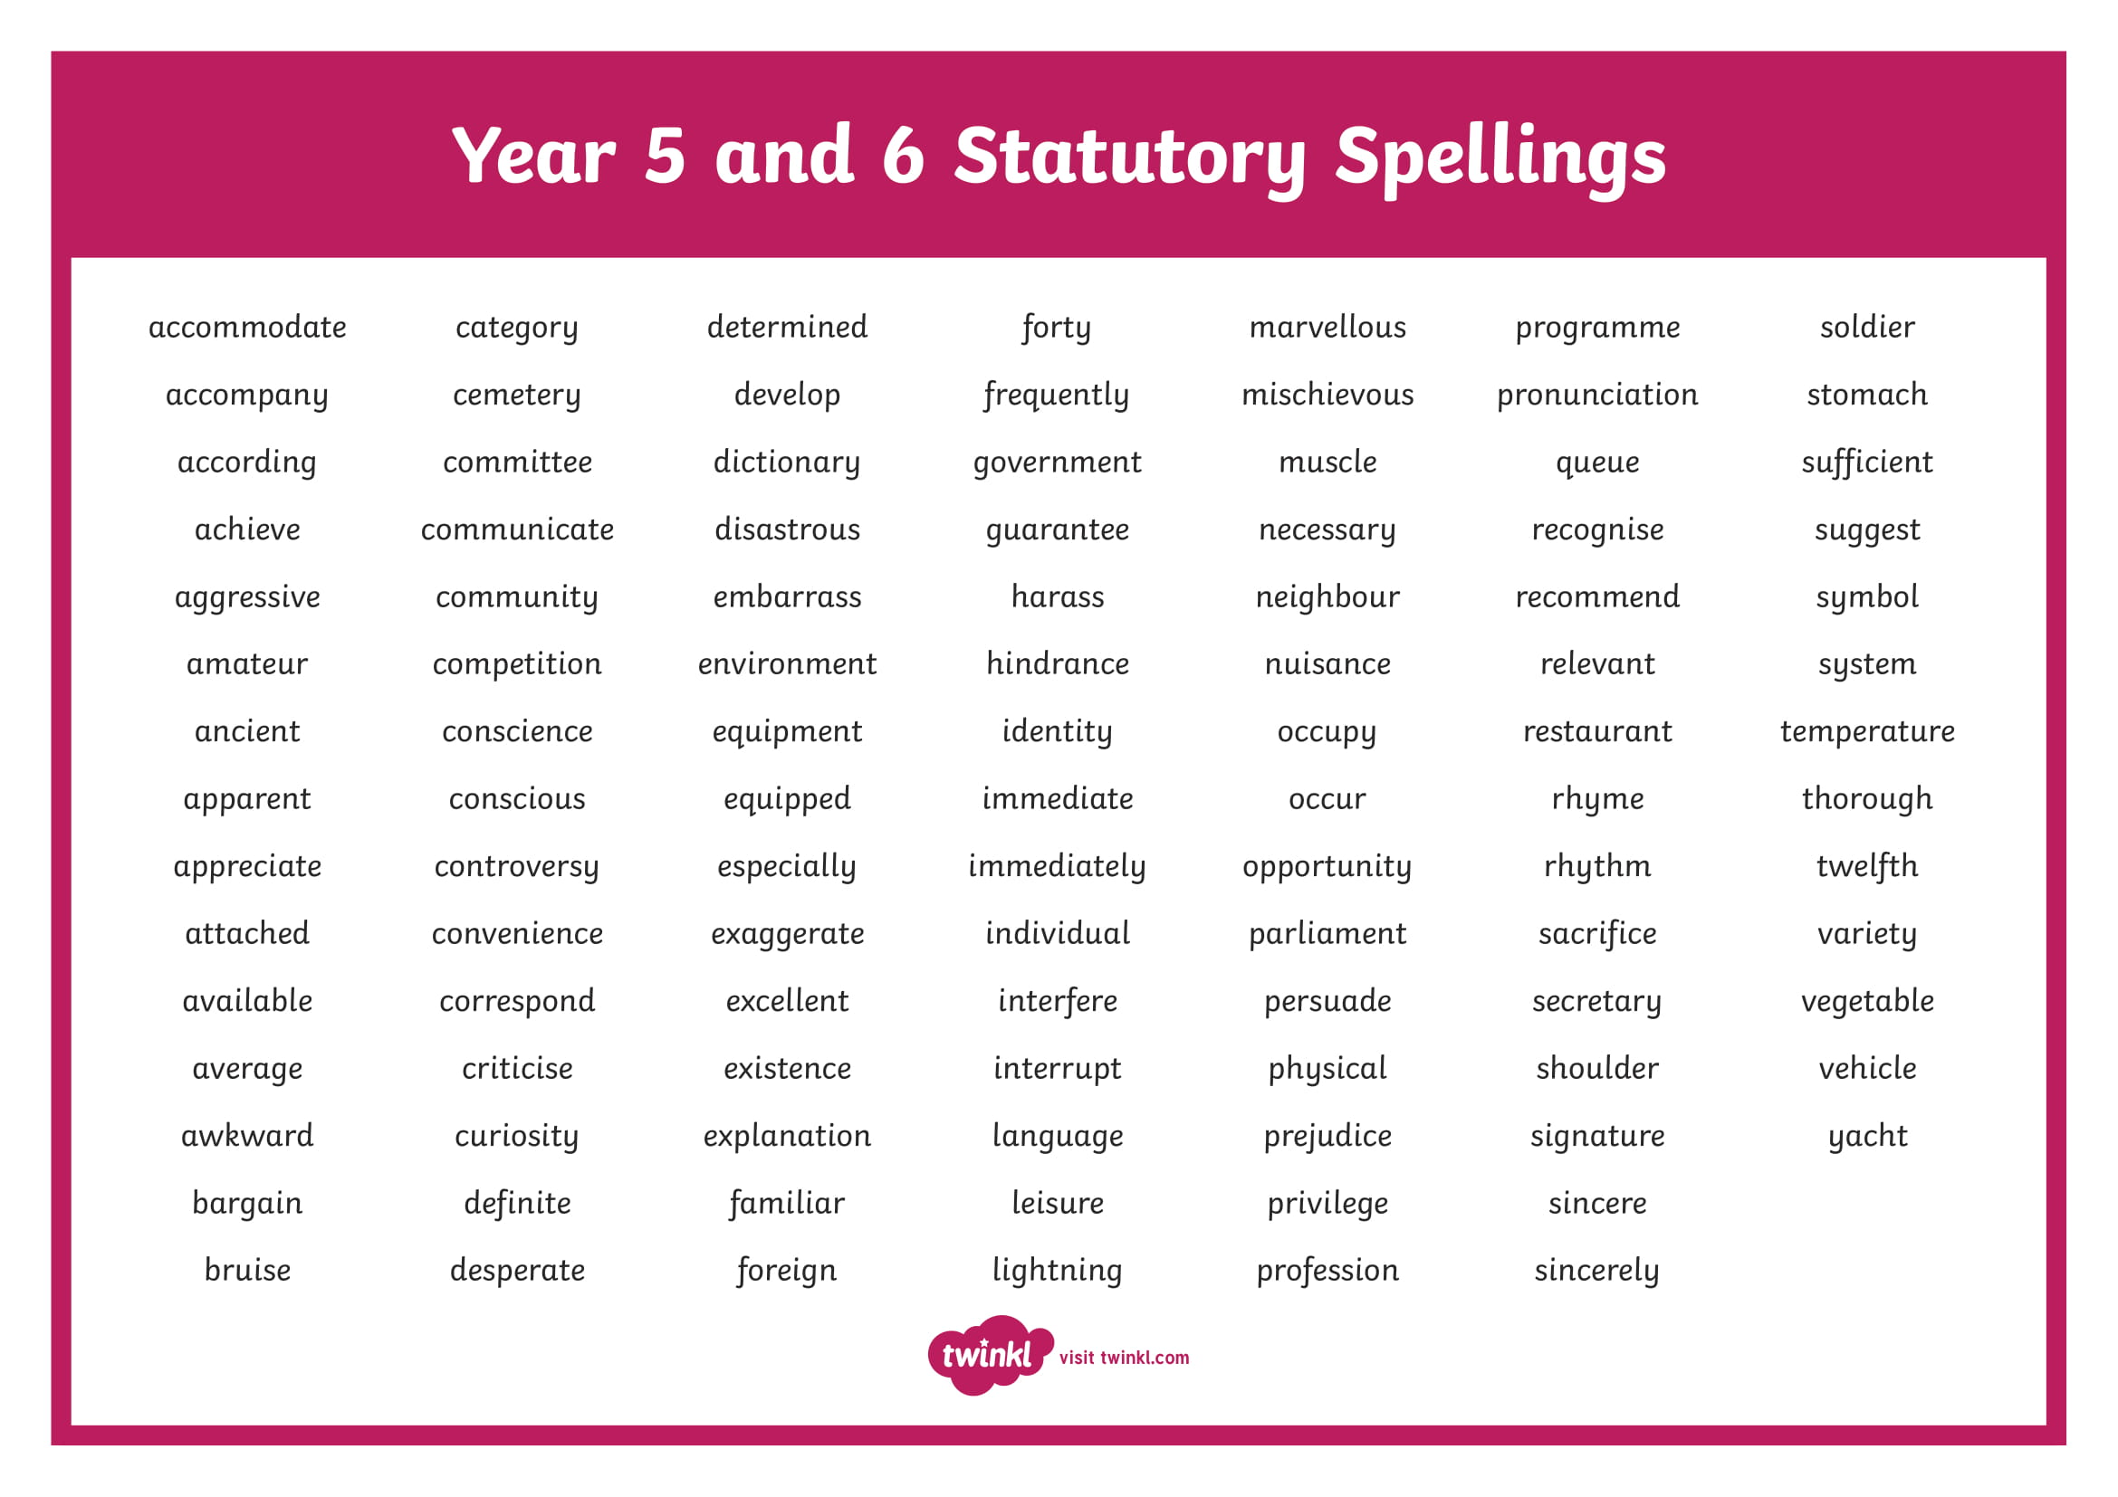
Year 5 spelling list

Slide 17
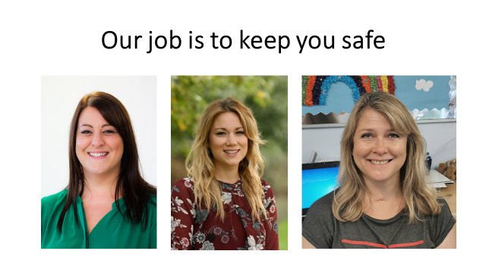

Safeguarding - Who can children talk to?
We encourage children to speak to a trusted adult in school if they have any worries or concerns
In each class there is also an ‘Ask it basket’ in which children can ‘post’ their worries in note form. These baskets are checked regularly by the teacher.
Children can sign up for weekly ‘Time to Talk’ sessions with Lauren (Zebra LSP and ELSA
trained) or Rachel (Lion class teacher and Samaritan trained).
Childline 0800 1111

Slide 18
Safeguarding
We have a duty to record and report safeguarding concerns and work alongside local agencies to ensure children are adequately safeguarded from harm. Please refer to our Child Protection and Safeguarding policy on the school website.
The Designated Safeguarding Lead (DSL) is Liz Strong
The Deputy Safeguarding leads (DDSL) are Rachel Chambers and Laura Wrigglesworth
Designated Teacher for Looked After Children (LAC) and post LAC is Laura Wrigglesworth
The Governor Designated Safeguarding Leads are Denise Long and Peter King - governors@kewriverside.richmond.sch.uk
If you have a concern about a child, you should contact the DSLs above. You can also contact the Single Point of Access (SPA):
Call 020 88547 5008 during office hours or 0208 770 5000 on evenings and weekends
Report your concerns online
If you think a child is in immediate danger call 999

Slide 19

Bike Helmets
We ask that all parents/ carers ensure that their children are wearing their helmets while travelling to school.
A gentle reminder that children are not permitted to ride their bikes and scooters on the school grounds.

Slide 20
E-Safety – Keeping Safe Online
We encourage all parents/carers to follow these guidelines/principles for keeping their children safe online:
Initiate (and continue) conversations with your child about online safety
Keep devices your child uses in communal areas of the house (eg living room or kitchen) where there are adults to supervise. It is not safe for 4-7 year olds to access the internet unsupervised in private spaces such as their bedrooms or bathrooms
Ensure parental locks are in place on all devices that your child may have access to
Make sure you are aware of the age restrictions of games, apps and movies that your child is accessing
Encourage your child to tell you if they see or hear anything that makes them uncomfortable. Be non-judgemental and offer support.
Please refer to the E-Safety section of the school website for resources and advice on all of the above.

Slide 21

Mobile Phones
In year 5 and 6 children are allowed to bring their mobile phones in at their own risk.
Phones are to be locked away at 9am and returned at 3.00pm
Please do not allow children to bring in expensive headphones to school. We cannot be held responsible for damage or loss of these items
Bike Helmets
As the children are permitted to cycle to school unaccompanied, we ask that all parents/ carers ensure that they are wearing their helmets.
Children will not be permitted to leave school with their bikes if they do not have adequate headwear.

Slide 22

Birthdays
At the moment, birthday gifts for class can only be given out outside the school gate.

Slide 23
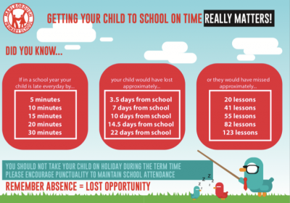
Home School Agreement

Slide 24
Useful websites and information
http://www.bbc.co.uk/bitesize/ks2/
https://www.topmarks.co.uk/
http://www.primaryhomeworkhelp.co.uk/maths/
https://www.spellzone.com/word_lists/games-10609.htm
https://uk.ixl.com/
https://home.oxfordowl.co.uk/at-school/year-6-at-primary-school/

Slide 25
Any Questions? Please send any questions to your class rep. Your class rep is Emilie Email ebalande@yahoo.fr

